Slide 1
By R.K. LAXMAN

Slide 2
OBJECTIVES
To enable the cadets to comprehend the gist of the story- Ishwaran the story Teller.
To provide a platform to the cadets where they can differentiate between natural and unnatural world.
To make the cadets able to understand difficult words.
To make the cadets able to answer all objective question and short notes on the basis of the story.
To make the cadets able to imagine another ending of the story.
To improve the reading, listening, speaking and writing skills of the cadets with help of this story.

Slide 3
About the writer R.K.Laxman

Slide 4
R.K LAXMAN
Born | Rasipuram Krishnaswami Iyer Laxman 24 October 1921 Mysore, Kingdom of Mysore, British India
Died | 26 January 2015 (aged 93) Pune, Maharashtra, India
Nationality | Indian
Occupation | Cartoonist, illustrator
Known for | Common Man cartoon
Spouse(s) | Kumari Kamala Kamala Laxman
Relatives | R. K. Narayan (Brother)
Awards | Padma Bhushan, Padma Vibhushan, Ramon Magsaysay Award

Slide 5
as A cartoonist
R.K.Laxman

Slide 6
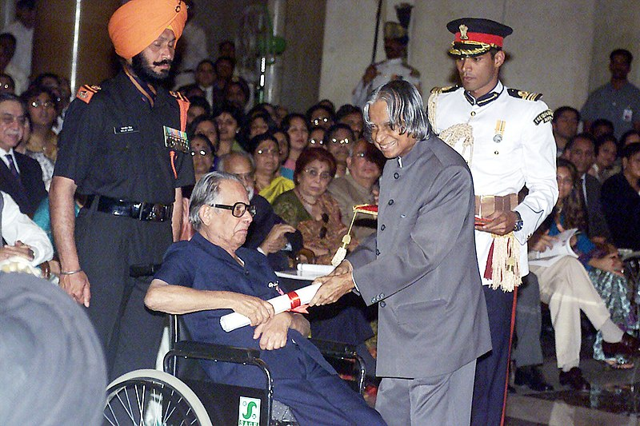
The well-known political cartoonist for the ‘Times of India’ Shri R.K. Laxman receives the Padma Vibhushan award from the President Dr. A.P.J. Abdul Kalam in New Delhi on March 28, 2005

Slide 7
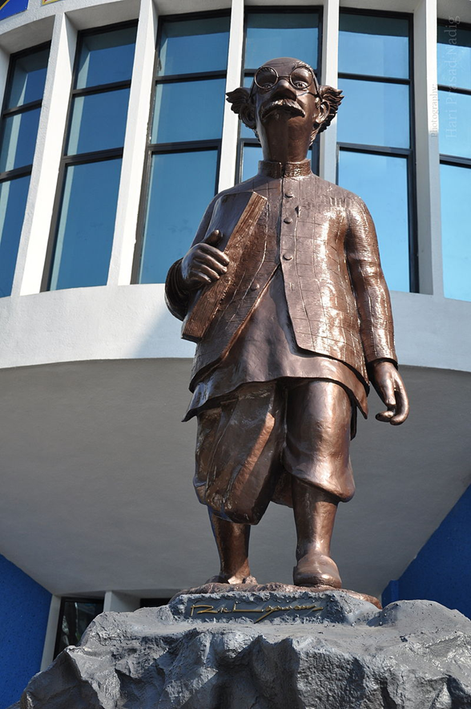
"The Common Man" by R K Laxman at Symbiosis Institute, Pune

Slide 8
The lost art of storytelling
Humans have been telling stories since 15,000 B.C. as a way to connect, entertain and pass along important information. In fact, we've been telling stories for so many years that it has become ingrained in our DNA... evolution has literally wired our brains for storytelling. Thousands of years of sharing and listening to stories has given the art of storytelling some unfathomable power. When we tell a story, the person listening can actually synchronize with us. Uri Hasson, professor of psychology at Princeton, gave an exceptional TED Talk where he explained the magical effects of storytelling..
"When the woman spoke English, the volunteers understood her story, and their brains synchronized. When she had activity in her insula, an emotional brain region, the listeners did too. When her frontal cortex lit up, so did theirs. By simply telling a story, the woman could plant ideas, thoughts and emotions into the listeners' brains."
.

Slide 9
INTRODUCTION TO THE LESSON
The title of this chapter- “Iswaran the storyteller” tells us that this story is about Iswaran who is a skilled storyteller. He uses special effects, does voice modulation, uses his body language to make the story realistic so that the listener, i.e. Mahendra gets attracted and captivated in his story. The writer wants to highlight this quality of Iswaran - that he was so good at telling stories that they appeared to be real. His stories were a source of entertainment for Mahendra.

Slide 10
THEME-I
The theme of the story is ‘the art of storytelling’. A good story becomes interesting only when the narrator twists and turns the action to make the narrative surprising yet plausible. Iswaran, a master of this art told gripping stories in a graphic and dramatic manner such that his listeners listened to him in rapt attention and bewilderment. Once the story of a female ghost that he recounted so terrified his master that he quit his job and left the haunted place.

Slide 11
Theme-2
Another theme is that, one must not let oneself be influenced by superstitions like ghosts or spirits. Mahendra believed that he had seen the female ghost because his subconscious seemed to have already accepted the presence of ghosts and spirits.

Slide 12
TITLE
“Iswaran the Storyteller” is a perfect title for a story that deals with the character ‘ Iswaran’ and his mastery of the art of storytelling. The whole story deals with the dramatic manner in which Iswaran made-up and recounted stories which were admirable more for the style in which elements of suspense, horror , and adventure were added to them than for their content . Hence, this title stands justified.

Slide 13
Message
The story gives the message that the unnatural world of ghosts and spirits is merely figment of our imagination. If we allow our hidden fears to take concrete shape and start believing in ghosts and spirits , our life would get disturbed . Mahendra was good at his job as a supervisor but had to quit because he allowed his fears to overpower his rational self.

Slide 14
A good story-teller should be an epitome of the qualities below mentioned:
should have vivid imagination.
should have good oratorical skills.
should be able to act during narration.
should use punctuation properly during narration.
should have the ability to vary the tone according to the situation.
should have amusing personality.
should be capable of creating and maintaining interest of the listeners.

Slide 15
SUMMARY
Mahendra was a junior supervisor in a firm which offered on hire supervisors at various types of construction sites. His job made him move every now and then from a coal mining area to a railway bridge construction site to some chemical plant after some months.
He was a bachelor. He had a cook named Iswaran. Iswaran accompanied Mahendra wherever he went and was therefore greatly attached to him. He not only cooked for Mahendra, and washed his clothes but also used to tell him stories in a very interesting manner. Iswaran loved to read popular Tamil thrillers in his leisure time. As a result, he innovated his own thrillers and would tell about it to Mahendra. Mahendra enjoyed listening to them because of the inimitable way in which they were told. Once he told his master a story about how he controlled a wild elephant that had gone berserk.

Slide 16
SUMMARY Contd..
He told that he came from a place famous for timber. The logs there were carried on to the lorries by elephants. They were huge well-fed beats. But when they turned wild, not even the most experienced mahout could control them. One day the elephant entered the school ground where children were playing, breaking through the brick wall. Children and teachers got terrified and rushed to the safe place.
But Iswaran was not scared. He moved towards the mad tusker with a cane in his hand and whacked its third toenail on the quick. The beast shivered from head to foot and then collapsed.
One day, while talking about the spirits of ancestors, he began to talk of ghosts. He said that the place where they were staying was once a burial ground and that he had sometimes seen ghosts at night. Being a brave man, he was not scared of them.

Slide 17
SUMMARY Contd..
Then he told his master about a horrible ghost woman seen only on a full moon night. She moaned and carried a foetus in her arms. Mahendra shivered at the description and told Iswaran that there were no such things as ghosts or spirits. He left the room and retired for the night. But he could not sleep. The story of the ghost woman began to hover in his mind.
One night, Mahendra was woken up from his sleep by a low moan close to his window. He looked out at the white sheet of moonlight outside, and found a dark cloudy form clutching a bundle. Mahendra was sure that it was none but the ghost woman.
He broke into a cold sweat and fell back on the pillow, panting. In the morning Iswaran asked him about the ghost woman and the sound of moaning that was coming from his room. But Mahendra was very upset. He decided to leave the place immediately.

Slide 18
Key Points
The story was narrated to Ganesh by Mahendra.
Mahendra was bachelor, junior supervisor in a construction firm.
His job was to keep an eye on different construction sites.
Mahendra always had his asset, his cook, Ishwaran with him.
Ishwaran had amazing capacity to produce vegetable and cookingingredients any where.
Ishwaran would read popular Tamil thriller stories.
His own description was greatly influenced by the Tamil author.
He weaved endless stories and played a roll of TV in Mahendra's living quarters.
He weaved a tale of a tusker, which destroyed everything on the way and how he made him collapsed in the end with help of a small cane and karate .

Slide 19
Key Points
Ishwaran linked the auspicious full moon night to a story of female ghost holding a foetus.
Mahendra rebuked him for explaining such baseless stories.
He thought that was only a figment of imagination and nothing else.
One night Mahendra heard a low moan near his window. He put it as a cat but sound became louder and louder.
Mahendra saw a cloudy figure holding a bundle.
It affected him very much that he could not sleep properly.
Next morning Ishwaran greeted him and told about the last night's experience.
At last Mahendra resolved to leave the place the very next day, handed in his paper.

Slide 20
WORD MEANING
Desolate: uninhabited, empty Conjure up: to gather or create with magic Zinc sheet shelter: a temporary place to live with the roof made of metallic sheets
Bachelor: a person who is unmarried Makeshift: temporary Quarry: mine Asset: advantage Anecdote: A short amusing or interesting story about a real incident or person
Muttering: speaking in a low voice Dozing off: falling asleep Narrative flourishes: detailed descriptions In thrall: The state of being in someone's power
Arched: curved Gesture: A movement of hands for head to indicate something Deserted: empty Enormous: huge

Slide 21
WORD MEANING
rapt attention: completely fascinated or absorbed by what one is seeing or hearing pick up the thread of the story: would not restart the story from where he left in order to arouse curiosity veterinary doctor: a doctor who specializes in treating animals Summoned: called Shrug: to raise one's shoulders slightly and momentarily to express doubt, ignorance, or indifference
Auspicious: good Delicacies: tasty food Spirits: souls of the dead Ancestors: elders of the family
culinary skills: related to cooking Garish: something which is too colourful and fancy that it is disliked Supernatural: related to ghosts and spirits
Reverie: a state of being pleasantly lost in one's thoughts; a daydream
Shrivelled: wrinkled and shrunken Foetus: unborn baby

Slide 22
WORD MEANING
Timber: wood that has been processed for commercial purposes Hauled: transported Prologue: an introductory speech Elaborate: detailed
Tusker: an elephant roam about: move around Stamping: hitting with force Emulation: Effort to match or surpass a person by imitation or copying
Outskirts: outer area helter skelter: here and there Panic: sudden fear causing unthinkable behaviour Grunted: Made a loud sound Depredations: Attacks which are made to destroy something
Hypnotize: to influence, control or direct completely as by personal charm, words or domination Mastering: putting together whacked: hit noisily Collapsed: fell

Slide 23
Check Your Understanding
In what way is Iswaran an asset to Mahendra?
How does Iswaran describe the uprooted tree on the highway? What effect does he want to create in his listeners?
How does he narrate the story of the tusker? Does it appear to be plausible?
Why does the author say that Iswaran seemed to more than make up for the absence of a TV in Mahendra’s living quarters?
Mahendra calls ghosts or spirits a figment of the imagination. What happens to him on a full-moon night?
Can you think of some other ending for the story?
Is Iswaran a fascinating storyteller? Discuss with your friends the qualities of a good storyteller. Try to use these qualities and tell a story.
What impact did Iswaran’s story of a female ghost have on Mahendra ?
Why did Mahendra become fond of Iswaran ?
Iswaran was a fascinating storyteller. What other skills he had ? How was he an asset to Mahendra?

Slide 24
Thank You!

